Slide 1
Architectures for the Internet of Things
Matthew King

Slide 2
The Task
Create a prototype system that can:
Collect temperature and light data
Send this data via the m qtt protocol to a broker
Automatic control of a heating system based on temperature
Triggering of lights at low levels
Other desired funcitonalitly

Slide 3
Basic System
Gather temperature and light data
send it to Adafruit.io
simulate feedback via LEDs
Automate the control of the light and temperature

Slide 4
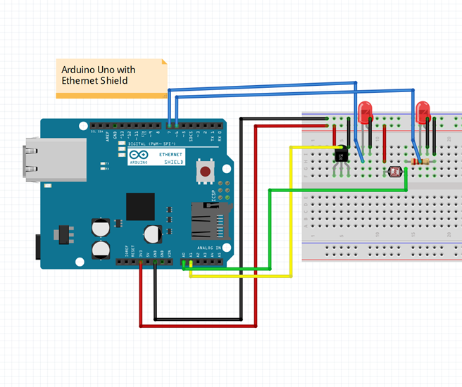

Slide 5
Optional Extras
Added and LCD to display the data
Kept the uptime messages from the arduino

Slide 6
